Slide 1
Memory Representation of Binary Tree
Lecture #
By: Abdul Aleem

Slide 2


Contents
1
Array Representation of Binary Tree
2
Linked List Representation of Binary Tree

Slide 3
Memory representation of binary tree
A binary tree is a hierarchical data structure in which each node has at most two children generally referred as left child and right child.
This hierarchical data structure can be represent in two way
Array representation: Most suitable for implementing Complete Binary Trees
Linked list representation: Most suitable for implementing sparse Trees

Slide 4
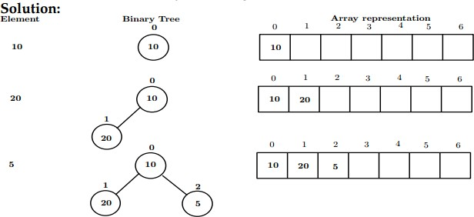
Array representation of binary tree
Example:
Construct a binary tree using elements 10, 20, 5, 30, 40, 60.

Slide 5
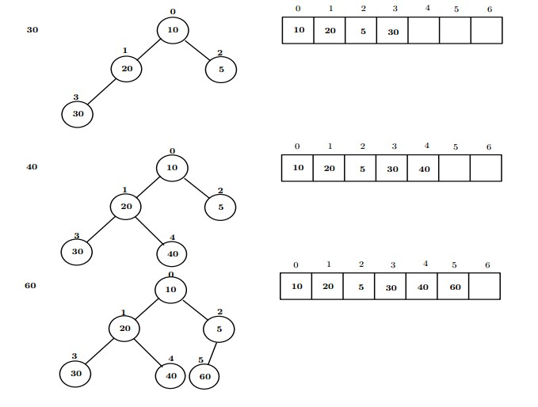
Array representation of binary tree

Slide 6
Array representation of Binary tree
This method is easy to understand and implement. It’s very useful for certain kinds of tree applications, such as heaps, and fairly useless for others. It’s typically used on dense binary trees.
The idea is simple:
Take a complete binary tree and number its nodes from top to bottom, left to right.
The root is 0, the left child 1, the right child 2, the left child of the left child 3, etc.
Put the data for node I of this tree in the Ith element of an Array.
If you have a partial (incomplete) binary tree, and node I is absent, put some value that represents ”no data” in the Ithh position of the array.

Slide 7
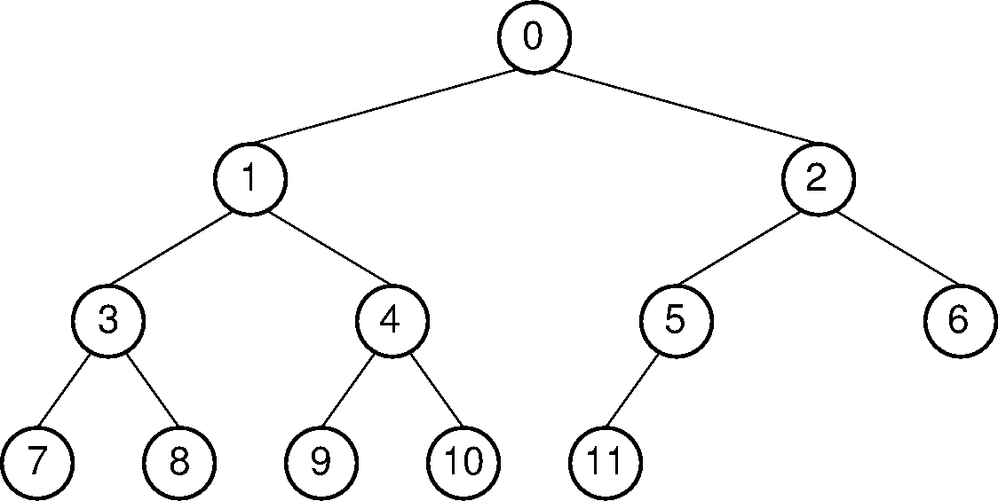
Array representation of binary tree
Example :

Slide 8
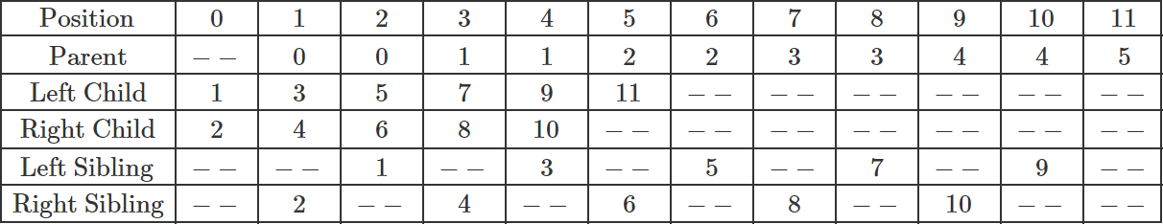
Array representation of binary tree
Here is a table that lists, for each node position, the positions of the parent, sibling, and children of the node.
Looking at the table, you should see a pattern regarding the positions of a node’s relatives within the array.

Slide 9
Array representation of Binary tree
The formulae for calculating the array indices of the various relatives of a node are as follows.
if index(parent) = N, index(left child) = 2*N+1 if index(parent) = N, index(right child) = 2*N+2
if index(child) = N, index(parent) = (N-1)/2 (integer division with truncation)

Slide 10
Array representation of binary tree
Advantages :
Easy traversal, which results in a faster search time. Efficient use of space if the tree is complete.
Disadvantages :
Fixed size of Array, which makes it harder to grow. Inefficient use of space if the tree is unbalanced.

Slide 11
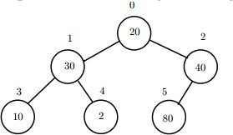
Array representation of binary tree
Practice Question:
If 1 is the index position of an element, what is its left child, and right child index position?
If 3 is the index position of an element, what is its left child, and right child index position?
If i is the index position if an element, what is its left child, and right child index position?
Construct a binary tree using elements A, B, C, D, E
Represent the following tree using array

Slide 12
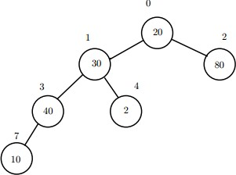
Array representation of binary tree
6. Represent the following tree using array.

Slide 13

Linked list representation of binary tree
Array representation is good for complete binary tree, but it is wasteful for many other binary trees.
To overcome this difficulty we represent the binary tree in linked representation.
In linked representation, each node contains three components:
1
2
3
Data Element
A reference to the Left subtree A reference to the Right subtree
In this linked list representation, a node has the following structure.

Slide 14
Linked list representation of binary tree
Each node of a binary tree can be stored as an object of a binary tree node class.
The class contains instance variables that are references to other nodes in the tree.
An entire tree is represented as a reference to the root node.
class BTNode
{
int info;
BTNode Left;
BTNode Right;
}

Slide 15
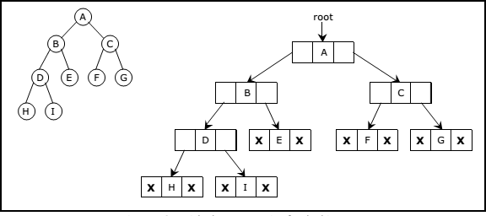
Linked list representation of binary tree
The reference to the root is similar to the head of a linked list, providing a starting point to access all the nodes in the tree.
If any subtree is empty then the corresponding left reference or right reference will be NULL.
In case of leaf node, the left reference as well as the right reference will be NULL.
If the tree itself is empty, the root reference will store a NULL value.
15 / 21

Slide 16
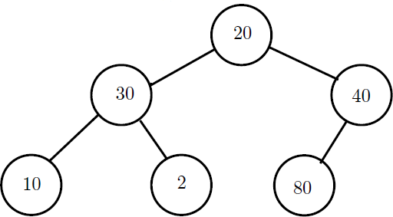
Linked list representation of binary tree
Problem : Represent the following tree using linked list.

Slide 17
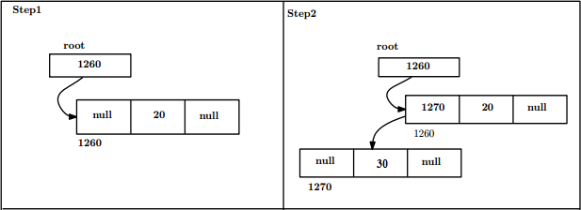
Linked list representation of binary tree
Solution :

Slide 18
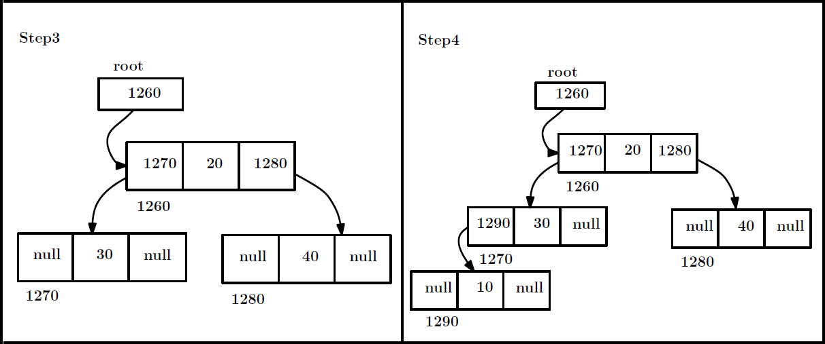
Linked list representation of binary tree

Slide 19
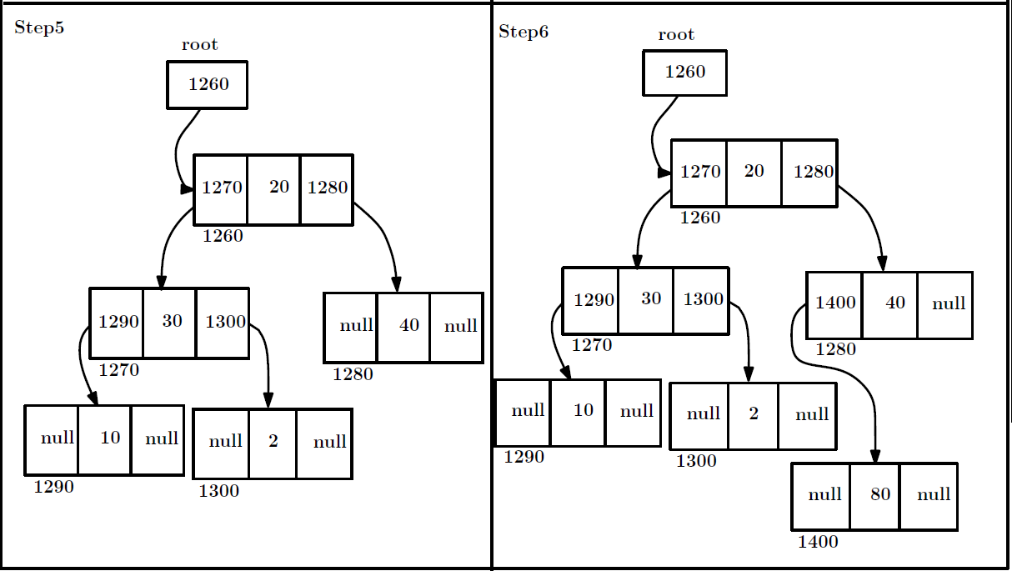
Linked list representation of binary tree

Slide 20
Linked list representation of binary tree
Advantages :
Dynamic Size.
Ease of Insertion and Deletion.
Disadvantages :
Random access is not possible. Extra memory with every element.

Slide 21
[1] Goodrich and Tamassia ‘Data Structures and Algorithms in java ’, Wiley, India.
References

